Slide 1


Customer Churn EDA

Slide 2

Total Customers
$ 440.8 K
Churners
Not Churners
$ 250 K
$ 190.8 K

Slide 3

Total Not Churners Spend
Total Churners Spend
$ 143 M
$ 145 M

Slide 4
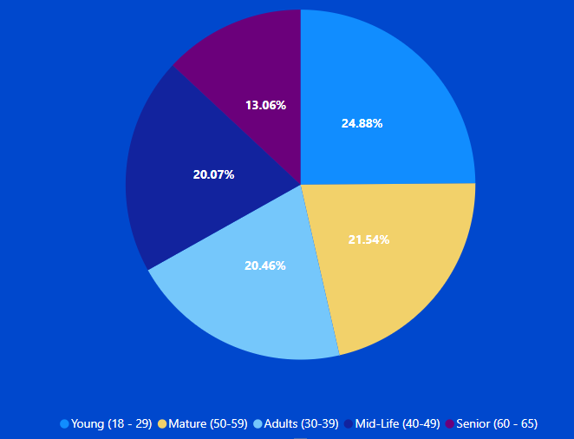
Age
As you can see almost half of the Curners in the Young (18-29) group

Slide 5
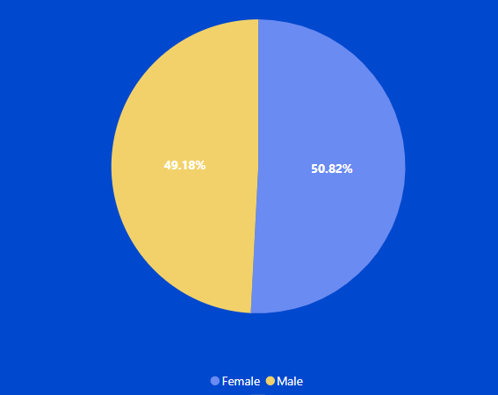
Customers Gender
Gender
Most of customers are Male
The most of churners are females customers

Slide 6
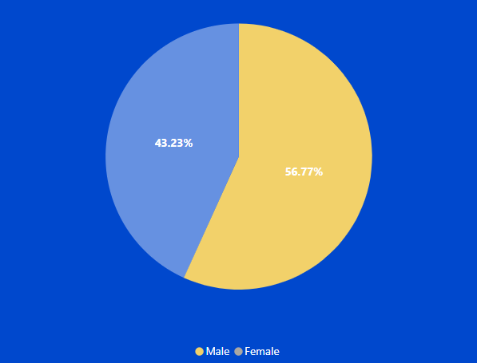
Churn Gender
Gender
Most of customers are Male
The most of churners are females customers

Slide 7
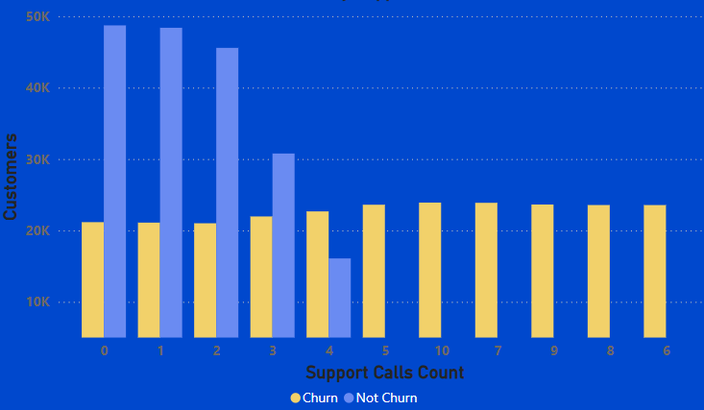
3%
Churners By Support Calls
Support Calls
There is an inverse relationship between customers who experience churn and customers who contact customer service. The more times the customer contacts, the more likely they are to experience churn.
The percentage of churners increases as the number of calls increases.

Slide 8
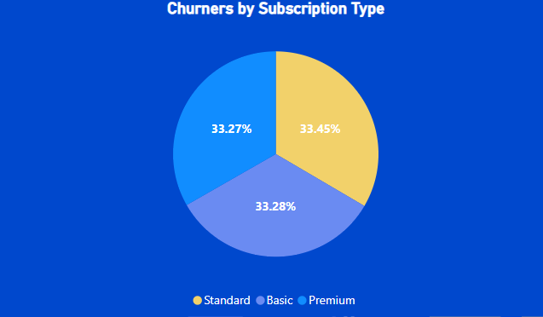
Subscribtion Type
All the customers with standard subscription have churn out.

Slide 9
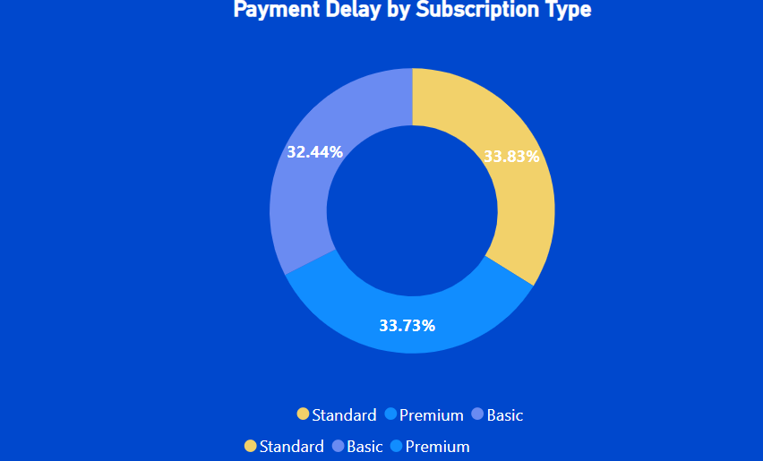
Subscribtion Type
Customers with standard subscription have the highest payment delay.

Slide 10
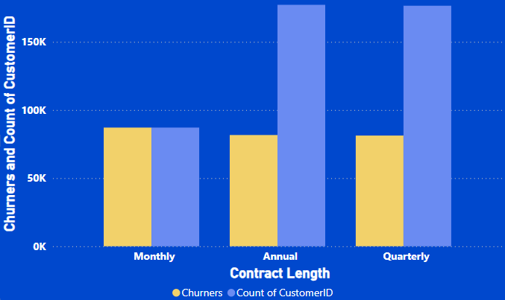
Contract Length
Almost half of customers with annual and quarterly contracts churn, but customers with monthly contracts all churn

Slide 11

Recommendaions

Slide 12



1
Young (18-29)
Comming Churner
2
Female
3
Customers who use support more than 3 times have a higher percentage of churn

Slide 13


4
Standard Subscription
Comming Churner
5
Monthly Contract length

Slide 14
What We Can Do To Prevent Customers to Churn out

Slide 15

What We Can Do To Prevent Customers to Churn out
Help and Improve the service for who make support calls more than 2 calls
1
Pay attention and improve the monthly contract
2
Improve the standard type of subscription
3

Slide 16

What We Can Do To Prevent Customers to Churn out
Pay More Attension by offering special packages for Young People (18-29)
4
Make Vouchers and Offers for Female churners to decrease the female churn rate and total spending of them
5
Make Vouchers and Offers for Female Churner To decrease the female churn rate and total spend of them
6

Slide 17
Thanks

